Slide 1

GSA SmartPay Fleet Management Essentials Rebekah Knouse Perillo
Notes:
Hello. My name is Rebekah Knouse Perillo and I am a Business Management Specialist with GSA’s Center for Charge Card Management.
Today, I will be presenting the GSA SmartPay Fleet Management Essentials course. This is a basic introduction about GSA SmartPay’s fleet business line.
Just a quick reminder that all of the forum courses are available on-demand through the end of July if you’re not able to attend the live sessions. You receive CLP credit when you attend live classes and when you attend on-demand classes.
OK, let’s go ahead and get started!

Slide 2
Overview
Notes:
First, we’ll start with some high level information about the GSA SmartPay program.

Slide 3
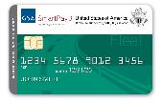
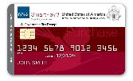
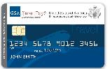
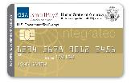
GSA SmartPay Program Overview
More than 560 Federal government agencies/ organizations can access charge card products and services through the GSA SmartPay 3 Master Contract.
Over 6.5 million accounts.
GSA SmartPay Master Contract awarded in 1998.
Notes:
The GSA SmartPay Program is the largest government charge card and related payment solutions program in the world. The program has over 6.5 million Purchase, Travel, Fleet, and Integrated accounts and supports more than 560 agencies/organizations across the federal government.
Since the award of the initial GSA SmartPay Master Contract in 1998, the GSA SmartPay Program has provided convenient, efficient, and effective payment solutions for the Federal Government, Tribes, and Tribal Organizations.

Slide 4
GSA SmartPay Program Overview
Federal government agencies/organizations issue task orders against the GSA SmartPay 3 Master Contract for charge card products and services from one of two contractor banks: Citibank and U.S. Bank.
Agencies/organizations pay no direct fees for using the GSA SmartPay Program.
Agencies/organizations have the opportunity to earn refunds.
Notes:
For the GSA SmartPay 3 program, also called SP3, there are two contractor banks: Citibank and U.S. Bank.
Agencies pay no direct fees for using the GSA SmartPay program.
And, one of the very best parts of the program for agencies, is the opportunity to earn refunds, which we’ll talk about in a bit later on.

Slide 5
GSA SmartPay Master Contract
Fixed price, IDIQ contract.
Maximum base period for the initial order is 4 years with three 3 year options (13 years).
The 4-year base period ended on November 29, 2022.
Agency awarded a task order to a GSA SmartPay contractor bank and to a fleet card issuer/brand.
Download a copy at smartpay.gsa.gov.
We are here!
2018 – 2022
(4-year base period)
2022 – 2025
(3-year option)
2025 – 2028
(3-year option)
2028 – 2031
(3-year option)
Notes:
Through contracts with Citibank and U.S. Bank, the GSA SmartPay program enables agencies/organizations across the Federal Government to obtain payment solutions to support mission needs.
The GSA SmartPay Master Contract, administered by GSA, is a fixed price, indefinite delivery/ indefinite quantity (or IDIQ) type contract.
The maximum base period for the initial order is four years with three, three-year options. The base period just ended on November 29, 2022. So, we are now in our first option.
To participate in the program, Agencies/Organizations must be eligible to issue a task order against the GSA SmartPay Master Contract.
So, your agency awarded a task order to one of the GSA SmartPay contractor banks and then selected a specific fleet card issuer - either Voyager for WEX. Another option is to award to one of the GSA SmartPay contractor banks and use Visa or MasterCard branded cards.
No matter which path your agency chose, it is through the task order, that accounts are set-up and managed by Agency/Organization Program Coordinators (or A/OPCs). The A/OPC has access to the banks’ Electronic Access System (EAS) and also works with the banks to resolve issues and answer questions. We’ll talk more about the A/OPC role in a bit.
Understanding the terms and conditions of the GSA SmartPay Master Contract is important to performing your role as a program coordinator. The terms and conditions of the Master Contract identify specific contractual requirements that the GSA SmartPay program has with the banks.
The GSA SmartPay Master Contract can be viewed on the GSA SmartPay website – which is smartpay.gsa.gov. Download a copy of the Master Contract and review relevant clauses and sections that pertain to the GSA SmartPay fleet program as well as the GSA SmartPay program in general.
Also, during the forum, we are offering a GSA SmartPay 3 Master Contract Basics course, so that may be helpful to attend. Please keep in mind that all forum courses are available on-demand through the end of July 2023.

Slide 6
Statistics
Notes:
Let’s take a quick look at some GSA SmartPay program statistics.

Slide 7
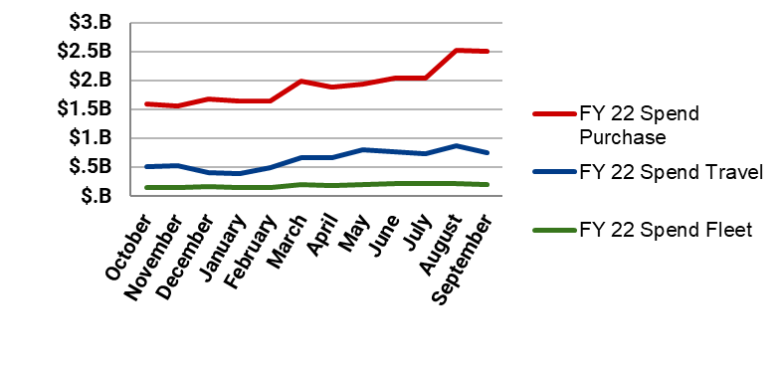
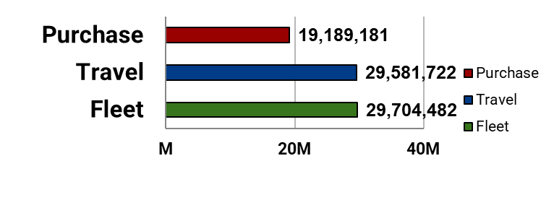
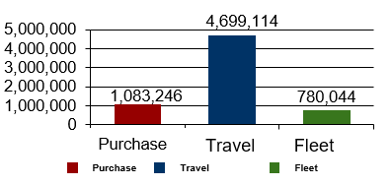
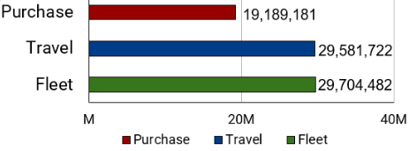
FY22 Program Statistics
Spend
Summary
Total Spend:
$32.8B
Total Transactions:
78.5M
12.4% vs. FY21.
12.9% vs. FY21.
Total Refunds:
$426.5M
Total Accounts:
6.56M
9.4% vs. FY21.
8.5% vs. FY21.
Transactions
Accounts
Notes:
First, we’ll look at the GSA SmartPay program overall, which includes all business lines (purchase, travel, integrated, and fleet). Then, we’ll review some fleet numbers separately.
So, here, you’ll see that the FY22 spend for the entire GSA SmartPay program overall was $32.8 billion dollars. This is up about 12% from FY21.
As far as refunds are concerned, total refunds were up in FY22, totaling over $426 million dollars. Again, these refunds go back to agencies to reinvest in their mission.
Transactions were up almost 13% in FY22, totaling over 78 million transactions.
And, total accounts were up about 8% in FY22, totaling 6.56 million accounts.
So, overall FY22 GSA SmartPay program numbers were very strong.

Slide 8
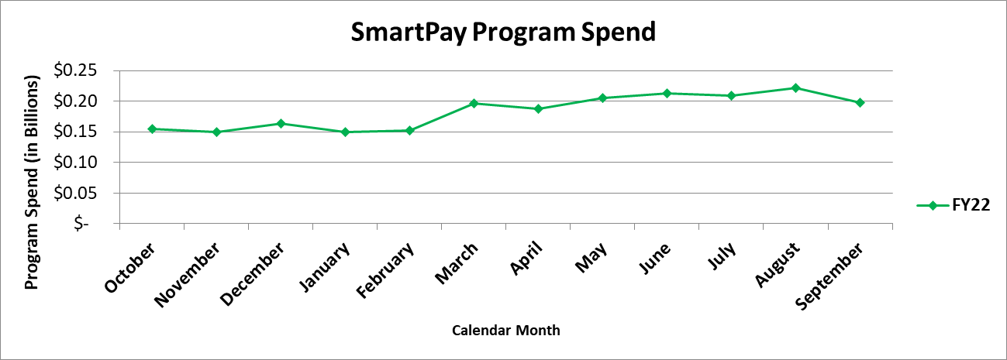
FY22 Fleet Spend
Fleet spend total $2.2B, 7% of total program spend ($32.8B).
Fleet | FY21 | FY22 | % Change
Spend | $1.7B | $2.2B | ▲ 33.3%
Transactions | 28.8M | 29.7M | ▲ 3.1%
Accounts | 813K | 780K | ▼ - 4.1%
Agency |  | FY 22 Spend | % of Fleet Spend
1 | U.S. Postal Service | $1.06B | 48.0%
2 | General Services Administration | $664M | 30.2%
3 | Department of Agriculture | $121M | 5.5%
4 | Department of Homeland Security | $118M | 5.4%
5 | Department of Interior | $85M | 3.9%
$2.2 Billion
Fleet Spend
Notes:
Now, let’s review some fleet numbers.
As mentioned before, the FY22 spend for the GSA SmartPay program overall was $32.8 billion dollars. Now, Fleet accounted for about 7% of that spend or about $2.2 billion dollars.
And, here you’ll see the top 5 agencies for fleet related spend.
In the top spot, you’ll see the U.S. Postal Service. They account for nearly half of the fleet spend.
Then, in the second spot, you’ll see the General Services Administration. They account for about 30% of the fleet spend.
After the U.S. Postal Service and GSA, the Department of Agriculture, Department of Homeland Security, and the Department of Interior follow to round out the top 5 for fleet related agency spend.

Slide 9

FY22 Fleet Refunds
Opportunity to Improve
Agency |  | $ (M) | % of Fleet Refunds
1 | United States Postal Service | $24.9M | 53.9%
2 | General Services Administration | $12.9M | 27.8%
3 | Department of Agriculture | $2.5M | 5.3%
4 | Department of Homeland Security | $1.9M | 4.1%
5 | Department of Defense | $1.5M | 3.1%
Keep in mind: Higher spend,
more refunds.
Notes:
Here’s some FY22 refund information for the fleet program. You can see the list of top 5 agencies for refunds here.
This slide serves as a reminder - there’s always an opportunity to improve. Increased spend leads to more refunds for your agency.
Therefore, your agency may want to consider using your fleet accounts more frequently or for more things or for higher dollar valued fleet related products and services. The higher spend will lead to an increase in the refunds that go back to your agency.

Slide 10
Key Participants
Notes:
Let’s review the roles and responsibilities of the key players associated with the GSA SmartPay program.

Slide 11
GSA SmartPay Key Participants
Brands
Account Holder
Center for Charge Card Management
OMB
Agencies/ Organizations
Inspector General
Banks
Notes:
Take a look at this graphic. As you can see, there are many different parties involved with the GSA SmartPay program. We’ll review these key participants in this portion of the presentation.

Slide 12
A/OPC Roles and Responsibilities
Focal point for answering charge card program related questions.
Setting up, maintaining, renewing, and terminating accounts.
Serving as a liaison between account holders and the contractor bank.
Providing ongoing advice and assistance to account holders.
Notes:
First up, we have A/OPCs. As an A/OPC, you are responsible for the overall management and oversight of the accounts under your span of control. I’m going to review the typical roles and responsibilities of the A/OPC but this may vary by level, depending on the hierarchies for control and oversight established at your agency. A/OPCs are the focal point for answering all questions related to the charge card program at the agency/organization level. A/OPCs also have several other responsibilities. Generally speaking, your responsibilities include:
Setting up, maintaining, renewing,and terminating accounts (we’ll talk more about this on the next few slides).
Serving as a liaison between account holders and the contractor bank.
Providing ongoing advice and assistance to account holders.

Slide 13
A/OPC Roles and Responsibilities
Developing agency policies and procedures, as needed.
Auditing accounts as required by your agency policy.
Using the bank's Electronic Access System (EAS) to perform account management and oversight.
Notes:
Developing agency policies and procedures, as needed.
Auditing accounts as required by your agency policy.
Using the bank's Electronic Access System to perform account management and oversight.

Slide 14
Renewing Fleet Accounts
At least 180 calendar days prior to the expiration of each account, the contractor bank will submit a report to the A/OPC listing each expiring account.
Fleet accounts used within the past 90 calendar days will automatically renew.
Notes:
A/OPCs renew fleet accounts. At least 180 calendar days prior to the expiration of each account, the contractor bank will submit a report to the A/OPC listing each expiring account, containing all information necessary for the agency/organization to renew the account. Fleet accounts used within the past 90 calendar days will automatically renew unless otherwise directed by the A/OPC.

Slide 15
Renewing Fleet Accounts
If the fleet account has not been used within the past 90 calendar days, the contractor bank shall close the account.
Renewed cards will be sent between 20-40 days before the expiration date.
Notes:
If the fleet account has not been used within the past 90 calendar days, the contractor bank shall close the account unless a renewal request is received from the A/OPC. Renewed cards will be sent between 20-40 days before the expiration date.

Slide 16
Suspending/Canceling Accounts
Number Calendar Days | Account Status/Action
46 days from the billing date | Pre-Suspension
61 days from the billing date | Suspension/ Pre-Cancellation
126 days from the billing date | Cancellation
180 days from the billing date | Charge Off/Write Off
Notes:
As the A/OPC, you have the discretion to initiate suspension and/or cancellation procedures for any account; however, you must document the reason for suspension and/or cancellation.
Suspension is the process by which an account is deactivated due to delinquency or multiple pre-suspension actions. An account is considered past due if payment for the undisputed principal amounts has not been received within 45 calendar days from the billing date.
The contractor bank may suspend an account when the account becomes delinquent. Once payment of the undisputed principal amount and Prompt Payment Act Interest is received, the bank is required to reinstate the suspended account, unless otherwise specified by the A/OPC. A/OPCs may also notify the bank of any mission-related, extenuating circumstances for which the account should not be suspended.
An account can be canceled if an undisputed balance remains unpaid for the prescribed number of calendar days after the date of the statement of account on which the charge first appeared. An account may also be canceled for numerous suspensions. Once an account has been cancelled, the contractor bank is under no obligation to reinstate the account.
Accounts may be cancelled through your bank’s electronic access system or through the bank’s customer service office.
The following chart may be used as a guide for determining the status of an account. Please refer to your agency policy for specific delinquency stages because they may be different than what I have here.

Slide 17
Closing/Terminating Accounts
Immediately notify the contractor bank.
Follow the account close out procedures from your contractor bank.
Instruct the account holder to destroy/dispose of the card.
Review the master file/account holder listing to ensure the account is closed.
Notes:
A/OPCs are responsible for closing and terminating accounts.
There are four steps to closing or terminating an account. They are as follows:
Immediately notify the contractor bank when an account is no longer required.
Follow the account close out procedures from your contractor bank.
Instruct the account holder to destroy/dispose of the card by cutting it into pieces.
Review the master file/account holder listing to ensure the account is closed.

Slide 18

Lost or Stolen Account
Instruct account holders to report a lost/stolen fleet account to:
Contractor bank.
A/OPC.
Supervisor.
Notes:
As a Program Coordinator, be sure to instruct your account holders to report a lost or stolen fleet account promptly to:
The contractor bank.
You, the program coordinator (A/OPC) and
Their supervisor.
Once an account has been reported as lost or stolen, the contractor bank immediately blocks that account from further usage and a new account number will be issued to the account holder.
Reporting the account as stolen does not relieve the account holder or the Government of payment for any transactions that were made by the account holder prior to reporting it stolen. If the account holder does not recognize a transaction appearing on their statement, they are responsible for notifying the contractor bank within 90 calendar days from the transaction date to initiate a dispute, unless otherwise specified by the agency/organization. This notification of transaction dispute may occur via the electronic access system, by telephone, or other electronic means like email.

Slide 19
Account Holder Roles and Responsibilities
Securing the account.
Maintaining records.
Using the account ethically and appropriately.
Understanding agency policy.
Reporting a lost or stolen account.
Monitoring expenses.
Disputing transactions.
Notes:
Next up, we have Account Holder Roles and Responsibilities - The account holder is the individual or agency/organization component designated by an agency/organization to use the account. Account Holders are the “first line of defense” when it comes to the proper use of the fleet card account. Account holders have a specific set of responsibilities that should be followed in the execution of the GSA SmartPay® Fleet program.
Account Holders should:
Secure their cards and account information (do not share PIN numbers, card numbers, etc.).
Maintain records relating to all fleet transactions.
Use the account ethically and appropriately.
Understand agency policies/procedures for use of the card and the terms of the account holder agreement.
Immediately report a lost, stolen, or compromised account as discussed on the last slide.
Monitor and track expenses and perform timely reconciliation.
Dispute transactions timely and in accordance with agency and bank policies.
Account holders should be reminded that fleet cards should only be used for expenses that fall with the fleet card solution -- they should not use the fleet card for purchase or travel purchases. For example: Do not use the fleet card to pay for personal travel expenses if the traveler left their GSA SmartPay® Travel card at home.

Slide 20
AO Roles and Responsibilities
Ensuring account is used properly.
Authorizing account holder purchases.
Ensuring that the statements are reconciled and submitted to the Designated Billing Office (DBO).
Notes:
There are Approving Officials (or AOs). An AO is the person (typically a supervisor) that is responsible for ensuring an account is used properly by the agency/organization. The AO authorizes account holder purchases (for official use only) and ensures that the statements are reconciled and submitted to the Designated Billing Office (DBO) in a timely manner.

Slide 21
DBO Roles and Responsibilities
Reconciling invoices.
Providing timely payment to the contractor bank.
Notes:
The Designated Billing Official or DBO generally serves as the focal point for receipt of official centrally billed invoices. The DBO also serves as the liaison between the agency/organization, the A/OPC and the Centrally Billed Account (or CBA) account holder. The DBO oversees the proper processing of invoices and ensures invoices are paid within the Prompt Payment Act timeframes.

Slide 22
TDO Roles and Responsibilities
Assisting the agency/organization and the contractor bank in tracking and resolving disputed transactions.
Notes:
Transaction Dispute Officer (TDO) - The TDO is an individual or office that may be designated by the ordering agency/organization to assist the agency and the contractor bank in tracking and resolving disputed transactions.

Slide 23
Banks and Brands
GSA SmartPay Account Service Providers
Citibank
Mastercard
Visa
WEX (Fleet)
U.S. Bank
Mastercard
Visa
Voyager (Fleet)
Notes:
Again, there are two contractor banks for SP3 – Citibank and U.S. Bank. The brands that work with Citibank are Mastercard, Visa, and for fleet transactions, Wright Express (also known as WEX). The brands that work with U.S. Bank are Mastercard, Visa, and for fleet transactions, Voyager.

Slide 24
Bank Roles and Responsibilities
Paying merchants for account transactions.
Establishing and issuing accounts.
Creating and maintaining an Electronic Access System (EAS) for agencies/organizations to utilize in managing the program.
Preparing monthly statements for each account holder.
Issuing invoices to the DBO for Centrally Billed Accounts (CBAs).
Notes:
The contractor bank’s major duties are:
Paying merchants for account transactions.
Establishing and issuing accounts.
Creating and maintaining an Electronic Access System (EAS) for agencies/organizations to utilize in managing the program.
Preparing monthly statements for each account holder.
Issuing invoices to the Designated Billing Official or DBO for Centrally Billed Accounts (CBAs).

Slide 25
Bank Roles and Responsibilities
Providing customer service 24/7.
Preparing reports.
Participating in an annual training forum, sponsored by GSA, that provides hands-on training on the EAS, sharing best practices, and addressing any issues and concerns.
Complying with all other terms and conditions of the GSA SmartPay Master Contract.
Examples include Citibank and U.S. Bank.
Notes:
The contractor bank’s major duties are:
Providing customer service 24/7.
Preparing reports.
Participating in an annual training forum, sponsored by GSA. During the forum, they share best practices and address any issues and concerns. When the forum is in-person, they provide hands-on training on the EAS.
Complying with all other terms and conditions of the GSA SmartPay Master Contract.
Examples of contractor banks include Citibank and U.S. Bank.

Slide 26
Brand Roles and Responsibilities
Dictate where payments can be processed.
Facilitate the payment process between account holders, merchants, and issuing financial institutions.
Examples include Voyager and WEX.
Notes:
The GSA SmartPay Brands are financial institutions that dictate where payments can be processed and facilitate the payment process between account holders, merchants, and issuing financial institutions.
Examples of brands include Voyager and WEX.

Slide 27
GSA Roles and Responsibilities
Center for Charge Card Management (CCCM)
Provides overall program management and advocacy.
Staff gsa_smartpay@gsa.gov for agency and account holder questions.
GSA Contracting Officer
Make any changes to any of the requirements of the GSA SmartPay Master Contract.
Legally commit or obligate the Government to the expenditure of public funds for the GSA SmartPay Master Contract.
Render a final decision on a dispute pertaining to the GSA SmartPay Master Contract.
Notes:
The Center for Charge Card Management (also known as CCCM) provides overall program management and advocacy. This is the group that I work for.
CCCM’s Service Delivery Branch provides customer service to all of the agencies and organization with SP3 task orders. Each agency/organization has a Point of Contact within our team. So, as an A/OPC, if you encounter an unusual situation or if you have any program related questions, feel free to reach out to your POC. We will do our best to answer your questions as soon as possible!
Agencies, organizations, and account holders can also reach out to our team via email (gsa_smartpay@gsa.gov). That inbox is staffed Monday – Friday from 8:00 a.m. to 4:00 p.m. ET with the exception of federal holidays. So, again, feel free to reach out to us. We are here to help!
Another person at GSA that is involved with the GSA SmartPay program is the GSA Contracting Officer. The CO administers the GSA SmartPay Master Contract on behalf of all authorized users, including your agency/organization.
The GSA Contracting Officer is the only person authorized to:
Make any changes to any of the requirements of the GSA SmartPay Master Contract.
Legally commit or obligate the Government to the expenditure of public funds for the GSA SmartPay Master Contract.
Render a final decision on a dispute pertaining to the GSA SmartPay Master Contract.

Slide 28
Other Involved Parties
Inspector General
Many agencies/organizations will have periodic audits of the your charge card program, and you will likely be a key player in those audits.
Office of Management and Budget (OMB)
Oversight of government-wide charge card program.
Notes:
So, are there any other parties involved with the GSA SmartPay program?
Because the GSA SmartPay program is a highly visible program and receives a lot of interest both within and outside your agency/organization, your management, the Inspector General (IG) staff and other investigators/auditors will likely be interested in the performance of your charge card program. Many agencies/organizations will have periodic audits of their charge card program, and you will likely be a key player in those audits.
OMB is also involved in the oversight of the government-wide charge card program. Additionally, you may find that OMB and Congress take an interest in the performance of your program. Your management and policy office will provide you with more information on handling audits, investigations and external inquiries if and when they come up.

Slide 29
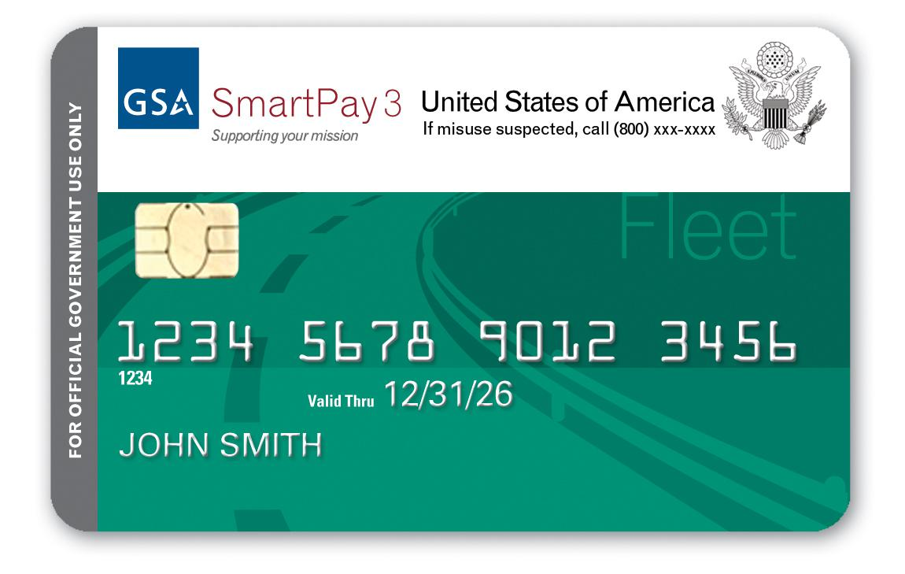
GSA SmartPay
Fleet Business Line
Notes:
So, now we know who’s involved in the GSA SmartPay program. Let’s dig in and talk more about some topics and information that specifically applies to GSA SmartPay’s fleet business line.

Slide 30
GSA SmartPay Fleet Program
Most Fleet accounts are assigned to a vehicle, not to an individual.
Fleet accounts are Centrally Billed Accounts (CBAs) and paid directly by the government to the bank.
Fleet accounts should be tax exempt.
Notes:
Most fleet accounts are assigned to a vehicle and not a specific account holder, therefore, a creditworthiness assessment is not required for receiving a fleet account.
In addition, use of the fleet account will not affect an account holder’s personal credit history. Any government employee authorized to use the GSA SmartPay program who has a responsibility to make fleet purchases and completes the necessary training is eligible to use a GSA SmartPay fleet charge card.
Because the agency is invoiced for purchases and payments are made directly to the contractor banks by the Federal Government, all fleet accounts are considered Centrally Billed Accounts (or CBAs).
And, because Fleet accounts are CBAs, they should be exempt from state taxes.
In addition, with a CBA, the Federal Government accepts liability for charges made by an authorized account holder, but is not liable for any unauthorized use. Unauthorized use means the use of an account by a person, other than the account holder, who does not have actual, implied or apparent authority for such use and from which the account holder receives no benefit. When the CBA has been used by an authorized account holder to make an unauthorized purchase, the Government is liable for the charge and the agency is responsible for taking appropriate action against the account holder.

Slide 31
Fuel, Maintenance, and Repairs
The governmentwide fleet account is authorized for the purchase of fuel, maintenance and repair of government owned/operated motor vehicles, aircraft, boats, and motorized equipment.
Notes:
Let’s talk a bit about uses for the fleet charge card. The governmentwide fleet account is authorized to be used for the purchase of fuel, maintenance and repair of government owned/operated motor vehicles, aircraft, boats, and motorized equipment. GSA SmartPay fleet accounts are assigned by Fleet Managers or Fleet Service Representatives. Federal Government or other authorized employees may use the fleet accounts assigned to that vehicle or equipment.

Slide 32
Fuel, Maintenance, and Repairs
Drivers typically can use the fleet card for fuel and for maintenance under $100 without needing approval.
For maintenance over $100 or for any accident damage, merchants typically must call for authorization before performing work on the vehicle and running the charge card.
Notes:
You’ll hear this quite a bit during this part of the presentation - Agencies have their own policy on many on the topics that we are going to discuss in this part of the presentation. So, please remember that your agency policy always rules. Please make sure that you know and understand your agency policy and please make sure that you share it out with your account holders.
But, generally speaking, drivers can use the fleet card for fuel and for maintenance under $100 without needing the merchant to call for approval.
For maintenance over $100 or for any accident damage, merchants must typically call for authorization.

Slide 33
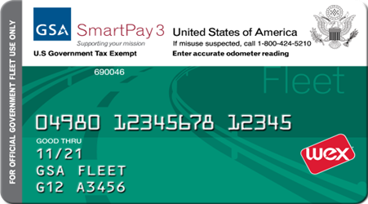
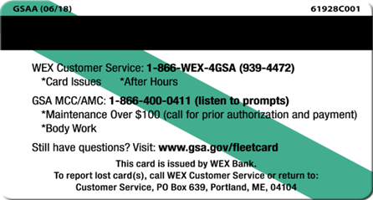
GSA Fleet Card Customers
Tax exempt remind vendors.
Enter correct odometer readings.
One card per vehicle.
One driver ID per card.
Service for fueling issues and repairs under $100.
GSA MCC/AMC for repairs or accident approvals over $100.
Notes:
So, when you have a moment, take a look at your agency’s issued fleet cards. This is an example of a GSA Fleet card. As mentioned earlier, each agency is responsible for issuing a Fleet card task order. So, your agency may be using a different bank/brand than GSA Fleet customers and your card art may have some customizations. Again, this is an example of a GSA Fleet Card - not all of your agencies and organizations will have this type of card. But, please take a look at your card when you have a moment. On this particular card, you’ll see that GSA SmartPay 3 referenced which is the current master contract for the program. There’s a reminder to vendors that the card is tax exempt since it’s a CBA (centrally billed account). There’s also a reminder for cardholders to enter the correct odometer readings at the pump. There is one card per vehicle.
One driver ID per card. For GSA Fleet card customers, on the back of the card, there are customer service numbers. If drivers have any issues for require approvals, they can reach out to the GSA Maintenance Control Center (GSA MCC) and/or Accident Management Center (AMC). Generally speaking, as mentioned on the previous slide, drivers can use the fleet card for fuel and for maintenance under $100 without needing the merchant to call for approval. And, for maintenance over $100 or for any accident damage, merchants must contact GSA Fleet for authorization prior to doing the work at 866-400-0411. For those with WEX fleet cards, some merchants are unable to process WEX cards. So, if they don’t electronically accept the WEX Fleet card, the vendor may call in the transactions to 866-WEX-4GSA (866-939-4472) to receive a Mastercard number, if preferred.

Slide 34
Fleet Account Approved Purchases
Authorized Purchases | Unauthorized Purchases
Use fleet charge card matching the license plate of the vehicle you are driving. | Using the wrong fleet card for a vehicle.
Regular unleaded, self service fuel for vehicle (or alternative fuels, as required). | Premium or full service fueling (unless required by state law).
Immediately consumable items for vehicle (e.g. quart of oil, washer fluid, wipers). | Convenience store items like maps, air fresheners, food, lottery tickets, alcohol, etc.
Exterior car washes within local guidance. | Over-maintenance of vehicle or excessive car washes or details.
Mechanical repairs for vehicle to which card is assigned. | Purchases at part stores, upgrading tires, accessories such as snow plows without prior approval from Fleet Service Representative.
Charging services for electric vehicles at commercial charging facilities.
Notes:
Generally speaking, here are some examples of authorized fleet card purchases, as well as some unauthorized purchases. Again, your agency policy rules.
Authorized Purchases
Use fleet charge card matching the license plate of the vehicle you are driving
Regular unleaded, self service fuel for vehicle (or alternative fuels, as required)
Immediately consumable items for vehicle (e.g. quart of oil, washer fluid, wipers)
Exterior car washes within local guidance
Mechanical repairs for vehicle to which card is assigned
Charging services for electric vehicles at commercial charging facilities
Unauthorized Purchases
Using the wrong fleet card for a vehicle
Premium or full service fueling (unless required by state law)
Convenience store items like maps, air fresheners, food, lottery tickets, alcohol, etc.
Over-maintenance of vehicle or excessive car washes or details
Purchases at part stores, upgrading tires, accessories such as snow plows without prior approval from Fleet Service Representative

Slide 35
“CHARGE” Act
Public Law 116-160 or the “CHARGE Act”.
Required GSA to issue guidance on the use of charge cards to pay for EV charging.
Smart Bulletin 036.
Notes:
Let’s talk a little more about how to pay for Electric Vehicle (or EV) charging.
Public Law 116-160, the “Charging Helps Agencies Realize General Efficiencies” Act or the “CHARGE” Act, required GSA to issue guidance on the use of charge cards to pay for charging federally-owned or managed EVs used for official government business at commercial charging stations.
GSA SmartPay issued Smart Bulletin 36, which provides operational guidance regarding the CHARGE Act.

Slide 36

EV Charging Stations
Use of GSA SmartPay charge cards for both per transaction and subscriptions for EV charging is permissible.
Type of card to be used must comply with agency policy.
Notes:
So, please take a look at Smart Bulletin 36 when you have a moment.
In short, the bulletin says GSA SmartPay charge cards can be used for both per transaction and subscriptions for EV charging - as long as your agency policy allows it and as long as the FAR allows it.
The type of GSA SmartPay charge card to be used (purchase, travel, integrated and/or fleet) to complete the charging transaction must comply with agency policy.
So, the specific type of GSA SmartPay solution used to pay for EV charging may differ depending on agency-specific policy.

Slide 37
EV Charging Stations
GSA SmartPay contractor bank charge cards (including WEX and Voyager fleet cards) can be used to pay at some charging stations.
Be aware that some charging station networks only accept Visa or Mastercard branded cards.
Certain charging stations have card readers for walk-up payments, while others do not.
RFID cards/key fobs may be used for payment.
Notes:
Some information to consider if you are working on crafting your agency’s EV charging policy…..
GSA SmartPay contractor bank charge cards (including WEX and Voyager fleet cards) can be used to pay at some charging stations.
However, other charging station networks only accept Visa or Mastercard branded cards - not WEX or Voyager – through their respective payment apps and terminals.
Certain charging stations have card readers for walk-up payment, while others do not.
If there is not card reader, RFID cards and key fobs that are linked to a GSA SmartPay card may have to be used by drivers to make payment.
So, there is a lot of variety in brand acceptance and how to pay at charging stations.
Please make sure your drivers understand your agency’s policy for EV charging, so that they’ll know where they’re able to charge their vehicle and how to pay for it.

Slide 38
EV Charging Stations
CCCM and the GSA SmartPay banks will continue to pursue relationships with charging station providers to increase access and acceptance at more charging networks.
Notes:
My office - the Center for Charge Card Management - and the contractor banks will continue to pursue relationships with charge station providers to increase access and acceptance at more charging networks for federal agencies.

Slide 39
Tolls on TDY - Typically…Travel Card
Agencies mostly utilize the GSA SmartPay Travel Card for the payment of tolls while on TDY.
However, agency policy dictates which type of card will be used.
Notes:
Toll payment policy is greatly debated among agencies and, ultimately, agency policy dictates how tolls will be paid. I will say that, most times, agencies seem to use the travel card when their account holders are on TDY. But other agencies may choose to use another form of payment.
So, please make sure you know your agency’s policy on toll payments and please share that policy with your account holders.

Slide 40
Toll Passes - It Depends!
Agency policy dictates if purchase, fleet, integrated, or travel cards can be to secure toll pass accounts.
Notes:
Agency policy also dictates if purchase, fleet, integrated, or travel charge cards can be used to secure toll pass accounts that require a card on file to charge per toll or replenish funds for tolls.
For example, I’ve heard that the Department of Interior has a policy for the use of the purchase card to pay for toll passes or transponders and details the circumstances for use.
So, please make sure you know your agency’s policy on toll passes and please share it out to your account holders.

Slide 41
Parking/Parking Passes - It Depends!
Agency policy dictates if purchase, fleet, integrated, or travel cards can be used for parking and parking passes.
Notes:
Again, agency policy dictates if purchase, fleet, integrated, or travel charge cards can used for parking and parking passes.
So, please make sure you know your agency’s policy and that you share it out to your account holders.

Slide 42
Section 889 Compliance
GSA FMR Bulletin B-53.
Agencies should establish their own policies addressing fleet card compliance with Section 889.
Agencies do not need to include provisions to obtain a representation from seller when using the fleet card for micro-purchases.
Provides guidance for fleet cards used for agency-owned and commercially-leased vehicles.
Fleet cards assigned to GSA Fleet fall under policy issued by GSA.
Notes:
889 compliance has become another hot topic over recent years and it applies to all business lines including fleet.
The Federal Acquisition Regulation (FAR) case 2018-017 prohibits the purchase of covered telecommunications equipment and services from vendors who sell products containing spyware. These devices could pose a threat to U.S. security by spying on or disrupting communications within the U.S.
Section 889 was implemented as part of the FY2019 National Defense Authorization Act. It contains two parts. Part A includes language that prohibits the government from obtaining equipment and services from a defined list of covered entities. This part is applicable to purchases including commercial items and micro-purchases. Part B focuses on language related to prohibition of entering into contracts with covered entities. It is applicable to all contracts, regardless of dollar value or sector.
Fleet card transactions generally carry a lower security risk, because the vast majority of fueling transactions and/or vehicle repairs do not involve the procurement of information technology or communication technology.
GSA's Office of Government-wide Policy issued GSA FMR BULLETIN B-53 regarding Section 889 and use of GSA SmartPay Fleet cards.
This bulletin states that agencies should establish their own policies addressing Government-issued fleet charge card compliance with Section 889. When these agency policies are established, you do not need to include provisions to obtain a representation or a report from seller/providers when using the fleet card for micro-purchases.
Typically, when the purchase of fuel, maintenance/repair of vehicles, or other transactions with a fleet charge card fall below the micro-purchase threshold in the FAR, representations or reporting from the seller/provider are not required. You do not need to obtain a representation or a reporting requirement when using a fleet charge card in these instances. However, if you are or become aware of a service station or repair facility which uses prohibited technology, make sure that that drivers do not buy from that entity.
GSA FMR Bulletin B-53 provides guidance related to fleet charge cards used for agency-owned and commercially-leased vehicles.
Just a quick note that fleet charge cards assigned to motor vehicles leased from GSA Fleet fall under the Fleet Purchase Card Policy that was issued by GSA.

Slide 43
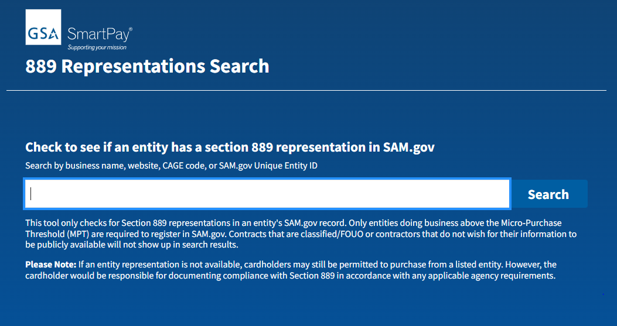
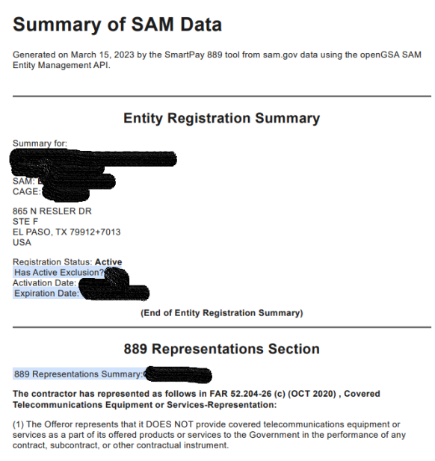
New 889 Search Tool
Protect your agency by checking the prohibited vendor list before making any telecommunications purchases.
Easy to use search tool.
Search by vendor name, website, CAGE code or UEI code.
Provides PDF if registered in SAM.gov.
Visit www.smartpay.gsa.gov.
Check out Smart Bulletin 33.
Notes:
Vendors are required by the FAR to provide information on whether or not they are providing covered telecommunications under contracts and orders with the Federal Government.
Our office has a new 889 tool that will go live on www.smartpay.gsa.gov around the end of this fiscal year.
So, if you are making a purchase that requires a vendor’s representations, the tool will help your agency because it will be an easy way to check to see if a vendor is in compliance with Section 889 before you make the purchase. Once you go to the tool, you’ll enter vendor information such as their name, website, Commercial and Government Entity (CAGE) code or Unique Entity ID (UEI). The tool will provide you the vendor’s 889 Representations Summary based on their System for Award Management (SAM) record at www.SAM.gov.
Please note: If a vendor’s representation is not available, account holders may still be permitted to purchase from a listed vendor. However, the account holder is responsible for documenting compliance with Section 889 in accordance with any applicable agency requirements.
You can read more about card management implications and information for agency consideration in relation to the Section 889 Prohibition on Acquiring Certain Telecommunications and Video Surveillance Equipment in Smart Bulletin 33, which is available at www.smartpay.gsa.gov.

Slide 44
Misuse and Fraud
Notes:
During this part of the presentation, we will review information on how you can minimize the risk of misuse or fraud in your GSA SmartPay fleet program. The most important thing an agency can do is to be aware of what activity is occurring on the accounts under their purview. Do not be afraid to ask questions if you identify unusual or suspicious transactions or behavior.

Slide 45
Misuse/Abuse
Common examples:
Purchases exceed the authorized limit.
Purchases for which no funding is available.
Using the fleet account for an unauthorized vehicle.
Split Transactions.
Products or services that do not meet the government's requirements.
Purchases for personal consumption.
Purchases that are not authorized by the agency/organization.
Notes:
Minimizing risk is very important. Misuse/Abuse can take many different forms, but here are some of the most common examples:
Purchases exceeding the authorized limit. Accounts may be limited to a specific spending limit per transaction, per day, or per monthly billing cycle.
Purchases for which no funding is available. Federal law requires that funds must be available before any government purchase is made.
Using the fleet account for an unauthorized vehicle. Account holders must take steps to ensure the security of their account. This means the fleet account must be used only by an authorized vehicle and only for official government business. If the account holder allows others to use the fleet account, the account holder will be held personally liable to the Government for any unauthorized transactions.
Split Transactions. The FAR limits the dollar threshold for micro-purchases. Any purchase that, as a whole, would exceed the micro-purchase limit but is separated into smaller transactions in order to avoid the micro-purchase limit is considered to be a split transaction.
Products or services that do not meet the government's requirements. Account holders must use discretion when making purchases to ensure that they meet the government's requirements. Due to the wide array of products and services available, there may be occasions when account holders may be requested or tempted to buy luxury or deluxe versions of products and services that exceed the government's actual requirements. For instance, it would be questionable for an account holder to buy a $200 car wash when there are many quality car washes available for $50 or less.
Purchases for personal consumption. All purchases must be for official government use only. Thus, any purchase made that is for the account holder's personal use rather than for official government purposes is considered to be misuse. For example, an account holder who uses the fleet account to buy himself lunch at the gas station because he had no cash available that day is misusing the account.
Purchases that are not authorized by the agency/organization. Your agency/organization may have additional limits on the use of the account, such as limiting certain categories or types of products or services.

Slide 46

Fraud
Fraud is a deception deliberately practiced with the motive of securing unfair or unlawful gain.
Notes:
Fraud is a deception deliberately practiced with the motive of securing unfair or unlawful gain.
Fraud can be an attempt to cheat the Federal Government and corrupt its agents by using GSA SmartPay payment solutions for transactions that are not part of official government business. Like any deception, fraud has its fair share of victims.

Slide 47
Fraud
Types:
Counterfeit Accounts.
Lost or Stolen.
Non-Receipt.
“Friends and Family” fraud.
Phishing.
Skimming.
Notes:
Let’s go over some types of fraud that agencies should be on the look for:
Counterfeit Accounts — To make fake cards, criminals use the newest technology to “skim” information contained on magnetic strips of cards, and also to pass security features (such as holograms).
Lost or Stolen Accounts — Often physical cards are stolen from an unattended vehicle.
Non-Receipt Fraud — This occurs whenever new or replacement cards are mailed and then stolen while in transit.
“Friends and Family” fraud – This is when an employee steals the card and uses it to fuel personal vehicles or a stranger’s vehicle often in return for a discounted cash price.
Phishing — Phishing occurs whenever an account holder receives a fake email directing him or her to enter sensitive personal information on a phony website. The false website enables the criminal to steal information from the account holder.
Skimming - Account information that is stolen at the pump.

Slide 48
Point of Sale Skimming
Skimmer devices usually fit over the original card reader.
Some skimmers are inserted in the card reader, placed in the terminal, or situated along exposed cables.
Pinhole cameras installed on pumps record a customer entering their PIN. Pinhole camera placement varies widely.
Notes:
Let’s talk a bit more about skimming.
Skimmer devices usually fit over the original card reader.
Some skimmers are inserted in the card reader, placed in the terminal, or situated along exposed cables.
Pinhole cameras installed on pumps record a customer entering their PIN. Pinhole camera placement varies widely.

Slide 49
Point of Sale Skimming
In some cases, keypad overlays are used instead of pinhole cameras to record PINs. Keypad overlays record a customer’s keystrokes.
Skimming devices store data to be downloaded or wirelessly transferred later.
Notes:
In some cases, keypad overlays are used instead of pinhole cameras to record PINs. Keypad overlays record a customer’s keystrokes.
Skimming devices store data to be downloaded or wirelessly transferred later.

Slide 50
Tips at the Gas Pump
Inspect the card reader before using it.
Pull at the edges of the keypad before entering PIN.
Cover the keypad when entering PIN to prevent cameras from recording the entry.
Use gas pumps that are in a well-lit location that are by the attendant.
Be alert for skimming devices in tourist areas.
Notes:
Here are some tips to consider sharing with your fleet account holders when they are at the gas pump.
Inspect the card reader before using it. Look for anything loose, crooked, damaged, or scratched. Don't use any card reader if you notice anything unusual.
Pull at the edges of the keypad before entering your PIN. Then, cover the keypad when you enter your PIN to prevent cameras from recording your entry.
Use gas pumps that are in a well-lit location that are by the attendant, which are less vulnerable targets.
Be alert for skimming devices in tourist areas, which are popular targets for skimming.

Slide 51
Tools to Reduce Misuse/Fraud
Program Management Tools:
Implement Credit limits.
Use Merchant Category Code (MCC) Blocks.
Review Online Reports.
Deactivate Accounts.
Notes:
Always follow your agency's policies and procedures when handling cases of suspected misuse and fraud.
Here are some program management tools that could help your agency reduce misuse and fraud:
Credit limits - Credit limits restrict single, daily, weekly, or monthly expenditures per account. In accordance with agency/organization policy, an A/OPC may set the limits which best meet the agency's needs. Setting limits that are realistic, but not excessive, will deter misuse. By reviewing spending patterns, A/OPCs may be able to lower limits without disrupting the agency's mission. A/OPCs also have the authority to raise limits at any time in response to emergency or unforeseen situations.
Merchant Category Code (MCC) Blocks - Merchant Category Codes (MCCs) are established by the associations or contractor banks to identify different types of businesses. Merchants select the codes that best describe their business. A/OPCs may limit the types of businesses where the account will be accepted by limiting the MCCs available to the account holder. In the event that a driver needs to make a purchase outside of his/her restricted MCCs, A/OPCs are authorized to override the restriction for a transaction by contacting the contractor bank's Customer Service Representative. Agency/organization policy should specify who is authorized to perform overrides.
Online Reports - A/OPCs have access to many standard and ad hoc reports online through the contractor bank’s EAS, which they can review to detect situations of potential fraud.
Account Deactivation - In those instances when the fleet account is not needed on a continuous basis, deactivation of the account may serve as a deterrent to fraud and/or misuse. A/OPCs may deactivate the account when an account is not being used. By understanding the use of the account, A/OPCs are able to establish deactivation guidelines.

Slide 52
Tools to Reduce Misuse/Fraud
Fleet A/OPCs can:
Establish policies and procedures to detect fraud, waste, and abuse.
Emphasize standards of conduct and clearly state consequences for misuse.
Manage delinquency and implement proper training.
Notes:
In addition, agency’s fleet program coordinators can:
Establish policies and procedures to detect fraud, waste, and abuse.
Emphasize standards of conduct and clearly state consequences for misuse.
Manage delinquency and implement proper training.

Slide 53
Tools to Reduce Misuse/Fraud
Drivers can:
Double check that they are using the correct card.
Keep their Driver ID/PIN confidential.
Ensure pumps are not compromised.
Use pumps that face the attendant.
Secure the fleet card when stored.
Notes:
Here are some tools that drivers can use to reduce fraud:
Double check that they are using the correct card before making a purchase.
Keep their Driver ID/ PIN confidential, do not write it on or near the physical card.
Ensure pumps are not compromised or opened.
Use pumps that face the attendant, they are less likely to have skimming devices installed.
Secure the fleet card when stored and don’t leave it in the vehicle or in a place accessible to all.

Slide 54
Suspected Misuse or Fraud
If a situation occurs where you must report suspected misuse or fraud, possible next steps may include:
Contacting the driver.
Compiling all the information.
Reporting to all required parties.
Notes:
Please keep in mind that misuse by employees impacts an agency’s charge card performance and refund earning potential.
A key responsibility for most program coordinators is to detect and report suspected misuse. If a situation occurs where you must report suspected misuse, make sure you have all the information necessary to assist with a formal inquiry or investigation. Contact the driver to obtain any information that could explain questionable charges. If the account holder provides documentation or an explanation regarding the charges and you still have questions or concerns about it, compile all the information (such as the statement, exception report, documented contacts between you and the account holder, copies of receipts, etc.) before you report it. Your agency/organization may ask you to report suspected misuse to one or more of the following personnel:
The Approving Official
The Finance Officer
The Office of Inspector General (via the hotline) or the Office of Special Investigations (for Defense agencies)

Slide 55
Consequences
Reprimand.
Counseling.
Suspension of employment
Termination of employment.
Criminal prosecution.
Note: Some agencies have agency-specific penalties and consequences for misuse/abuse of the fleet account.
Notes:
Consequences for misuse, abuse or fraud may include:
Reprimand
Counseling
Suspension of employment
Termination of employment
Criminal prosecution.
Please note that some agencies have agency-specific penalties and consequences for misuse/abuse of the fleet account.

Slide 56
Best Practices
Notes:
During this part of the presentation, we’ll talk about some best practices for your consideration. Each agency runs their charge card program a bit differently. But, perhaps you’ll find some of these ideas and suggestions helpful and perhaps your agency will consider implementing some of these suggestions if you haven’t done so already.

Slide 57
Best Practices - Suggestions
Train account holders on the proper use of the fleet account. Use ethics training as another source for instruction.
Develop a fleet hotline to respond to account holder questions.
Develop and maintain a fleet-specific website for your agency.
Create a monthly newsletter for agency fleet policies
and procedures.
Notes:
Good training and regular communication with your account holders is key! Here are some suggestions that A/OPCs may be able to use to improve your fleet charge card program:
Again, training is also a powerful tool - for both A/OPCs and fleet cardholders - to ensure the success of your agency/organization’s GSA SmartPay Program.
Develop a fleet hotline to respond to account holder questions.
Develop and maintain a fleet-specific website for your agency.
Create a monthly newsletter for agency Fleet policies and procedures.

Slide 58
Best Practices - Suggestions
Publish “Frequently Asked Questions” on the agency’s internal website.
Send periodic reminders on agency fleet policies and procedures.
Hold orientation sessions with new account holders.
Email updates to A/OPCs at all levels on program changes.
Perform annual review.
Notes:
Publish a “Frequently Asked Questions” page on the agency’s internal website.
Send periodic reminders on agency fleet policies and procedures.
Hold orientation sessions with new fleet account holders.
E-mail updates to A/OPCs at all levels on important program changes.
Consider performing an annual review of all issued accounts to determine whether each account meets the criteria for continued participation in the Federal Government fleet program.

Slide 59
Best Practices - Reporting
A/OPCs have access to reports to manage their fleet program effectively through their bank’s Electronic Access System (EAS).
A/OPCs should reach out to your bank for User ID/password.
EAS allows monitoring account holder transactions at any time.
Notes:
Program Coordinators have access to a number of reporting tools that enable you to manage your fleet program effectively through your contractor bank's Electronic Access System (EAS). To access reports, contact your bank representative to obtain a User ID and password.
Each bank has a slightly different suite of reports available, so review the contractor bank's A/OPC guide or go online to learn about the specific reports offered. Most electronic reports are updated within two to three days after a transaction. However, some reports are only updated at the end of the billing cycle.
Program coordinators will also have access through the EAS to monitor account holder transactions at any time. By searching by account number, you can track transactions, as well as view monthly statements. You may also contact the bank’s customer service at any time to request information on a specific account.

Slide 60
Best Practices - Reporting
Take the time to understand all available reports.
Proactively review reports regularly.
Use exception reports to detect misuse of the fleet account or unusual spending patterns.
Use ad hoc reporting tools to customize and/or develop your own agency reports.
Save copies of all generated electronic reports, particularly statistical or summary reports.
Notes:
So, be sure to use the online tools provided by the banks, GSA, and your agency.
Take the time to understand all available reports.
Proactively review reports regularly to oversee the fleet account program’s financial condition, to monitor for fraud, waste, and abuse, and to track trends in delinquency rates and charge offs/write offs.
Use exception reports to detect misuse of the fleet account or unusual spending patterns.
Use ad hoc reporting tools to customize and/or develop your own agency reports and to eliminate manual calculations.
Save copies of all generated electronic reports, especially statistical or summary reports. Due to the volume of information available, the bank will furnish information for a limited period of time (generally, 18 months or less) before archiving the data. Reports containing sensitive information (like account numbers, account holder information, etc.) should be maintained in a secure location. Review and follow your agency/organization policy for instructions on printing and safeguarding reports.

Slide 61
Resources
Notes:
And, in closing, as charge card managers, please continue to review the GSA SmartPay website, read the GSA SmartPay Master Contract, study your agency’s task order, attend the yearly GSA SmartPay Training Forum, and talk with your fellow A/OPCs to learn more about the GSA SmartPay program overall, as well as your agency’s specific charge card program policies.
Also, it is helpful to get to know your bank's Customer Service Representatives and Account Managers. They can provide a wealth of information and are ready and able to answer questions to help you manage your program. Many of your responsibilities as an A/OPC involve a working relationship with the contractor bank.
Before we go, I’d like to share a few resources with you.

Slide 62
Centralized Mail List Service (CMLS)
CMLS Information
Phone Number: (800) 488-3111 Email: ncsccustomer.service@gsa.gov
Helpful Hints for Fleet Account Use
Notes:
Go to the Centralized Mail List Service (CMLS) to order hard copies of the GSA SmartPay guides and publications. Simply refer to the specific publication by title or document ID. Both printing and shipping is free for agency customers.
If you click on CMLS Information link on this slide, you’ll learn more about this service. I’ve also provided the phone number and email here for you.
I’ve also linked the publication named the GSA SmartPay Fleet Helpful Hints which is for federal civilian and military audiences. This mini-booklet contains the dos and don'ts for Fleet Account use, procedures for reporting a lost or stolen card, and bank resource information. So, you may want to provide this to your account holders.
And, after this presentation, it may be helpful for you to download this PowerPoint so that you can keep this information on hand.

Slide 63
Forum PowerPoints
Go to gsasmartpayforum.org.
Click on the “Presentations/CLPs” tab at the top of the page.
Then, you’ll see how to access GSA PowerPoints, as well as bank/brand PowerPoints.
GSA PowerPoints are housed on smartpay.gsa.gov.
Notes:
And, how do you access the forum PowerPoint decks? If you’re interested in downloading the forum PowerPoints, they are another great resource to keep on hand. Just go to the forum website – gsasmartpayforum.org.
At the top of the screen, click on the “Presentations/CLPs” page.
Then, you’ll see links to the forum PowerPoints for the GSA presentations, as well as for the bank and brand presentations.
GSA PowerPoints for the forum are housed on our program website – smartpay.gsa.gov. And, later on after the forum’s event portal closes, you’ll likely see some of the training videos for the GSA classes on smartpay.gsa.gov. So, if some of your colleagues did not attend this year’s forum, they may be able to view some of the training videos later on after this event is over – however, they will not receive CLP credit like you are receiving today!

Slide 64
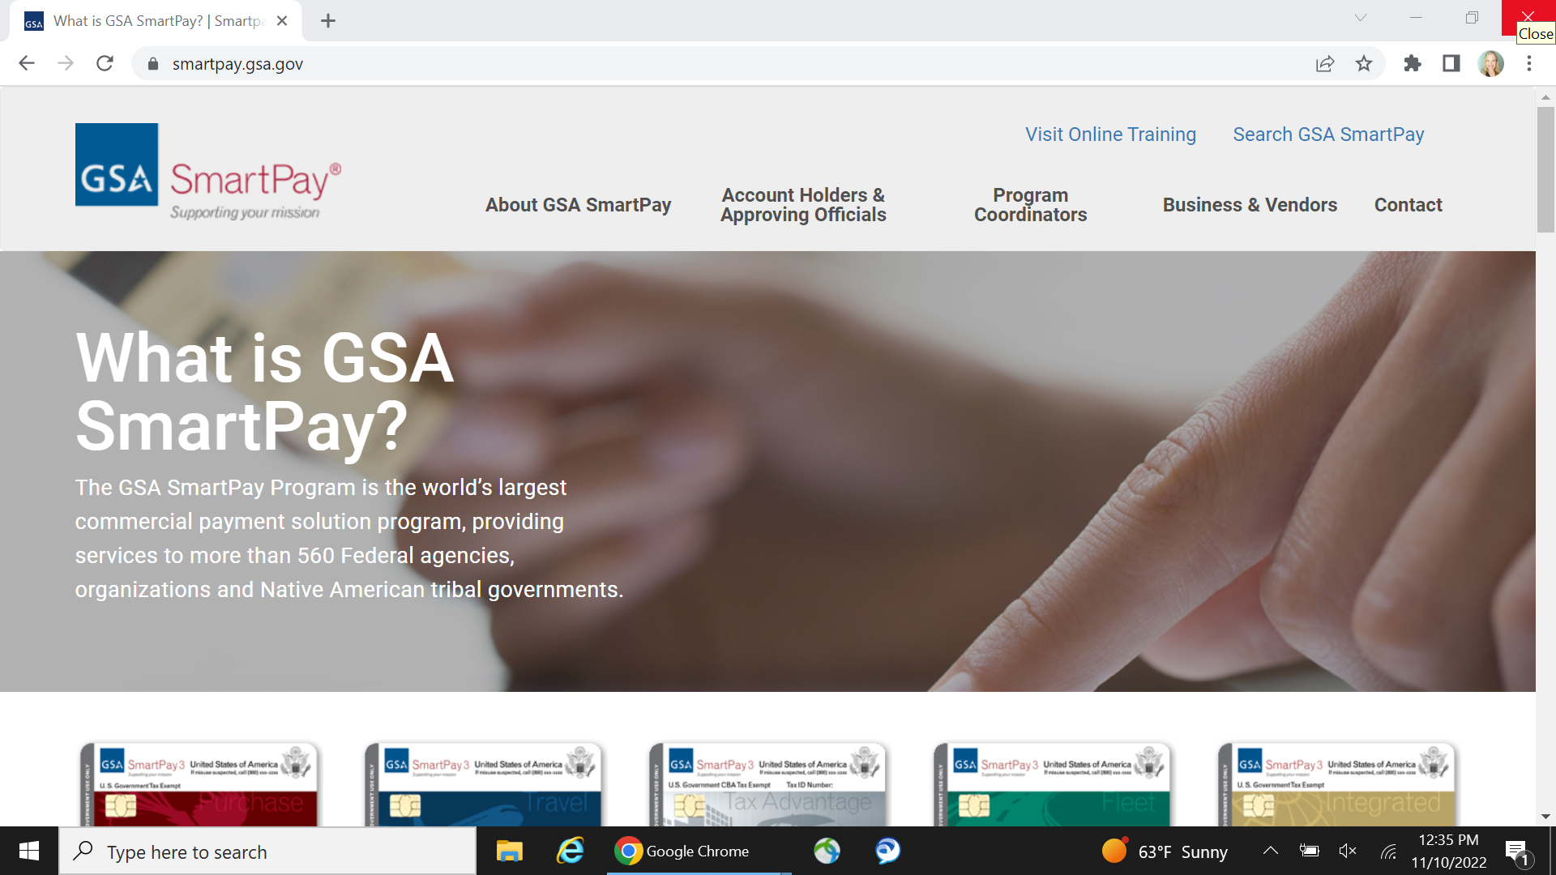
smartpay.gsa.gov
GSA SmartPay Program Website
Notes:
Here’s our program’s website that I mentioned throughout today’s presentation - smartpay.gsa.gov.

Slide 65
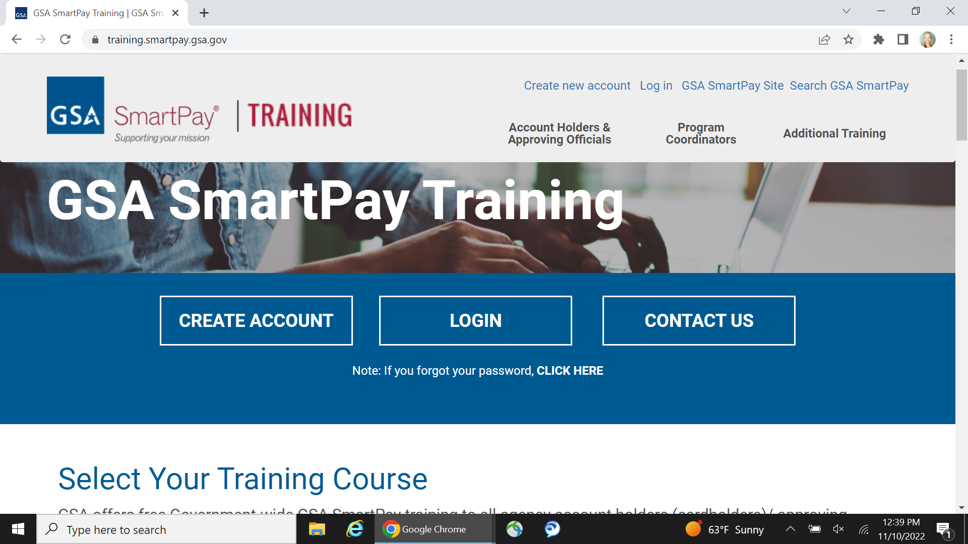
training.smartpay.gsa.gov
GSA SmartPay Training Website
Notes:
…and here’s our program’s training website - training.smartpay.gsa.gov.
The Center for Charge Card Management (CCCM) offers free online fleet training for A/OPCs at training.smartpay.gsa.gov.
To access the Fleet A/OPC training, click on “Program Coordinators”, then on “Fleet” from the drop-down menu.
There is no fleet training for Account Holders and Approving Officials on our training site at this time.

Slide 66

GSA’s Center for Charge Card Management
gsa_smartpay@gsa.gov Monday – Friday 8:00 a.m. - 4:00 p.m. ET Excluding federal holidays
Notes:
Agencies, organizations, and account holders can also reach out to our team via email (gsa_smartpay@gsa.gov). Our inbox is staffed Monday – Friday from 8:00 a.m. to 4:00 p.m. ET with the exception of federal holidays. So, again, feel free to reach out to us. We are here to help!

Slide 67
Citibank
(800) 790-7206 (within United States)
(904) 954-7850 (collect calls from outside United States)
Citibank Online Account Access
Notes:
Here’s Citibank’s contact information.

Slide 68
U.S. Bank/Voyager
(888) 994-6722 (within United States)
(701) 461-2232 (collect calls from outside United States)
U.S. Bank Online Account Access
Notes:
And here’s U.S. Bank’s contact information. Voyager is owned by U.S. Bank, so if you need to reach out to them, you may use this contact information.

Slide 69
Wright Express (WEX)
Customer Service: 1-866-939-4472
WEX Online Account Access
Notes:
And, here’s WEX’s contact information.

Slide 70

Contact Information
Rebekah Knouse Perillo rebekah.knouse@gsa.gov
Notes:
And, now we have reached the end of today’s GSA SmartPay Fleet Management Essentials course. I hope that you have found it useful and helpful and perhaps you’ve learned some new information. Again, my name is Rebekah Knouse Perillo and here is my email address - rebekah.knouse@gsa.gov. Feel free to reach out to me at any time if you have any questions. Thank you for your time and attention! Have a wonderful day!

Slide 71
GSA Starmark Logo

